Slide 1
Apache Ambari Overview
Nitiraj Rathore
Pallav Kulshreshtha
April 2017

Slide 2
Agenda
Background, Release History
Ambari Alerts and Metrics
Ambari Blueprints
Security Setup (Kerberos, RBAC)
Automated Cluster Upgrade
Extensibility: Stacks and Views
Demo

Slide 3
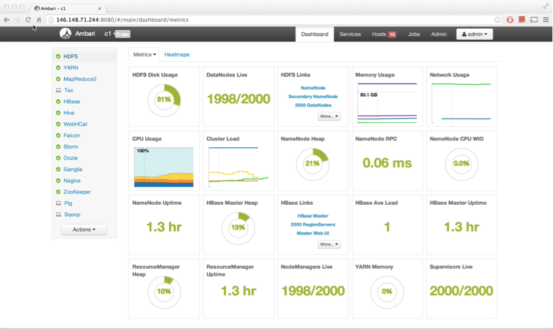
What is Apache Ambari?
A completely open source management platform for provisioning, managing, monitoring and securing Apache Hadoop clusters. Apache Ambari takes the guesswork out of operating Hadoop.

Slide 4
Ambari Recent Releases
Ambari 2.2.0
Dec 2015
Ambari 2.2.2
Apr 2016
Ambari 2.4.0 GA
Aug 2016
Ambari 2.5.0 GA
April 2017
Introduced Grafana
Introduced
Log Search TP
Introduced
Hive LLAP GA
Introduced Express Upgrade

Slide 5
Ambari Alerts

Slide 6
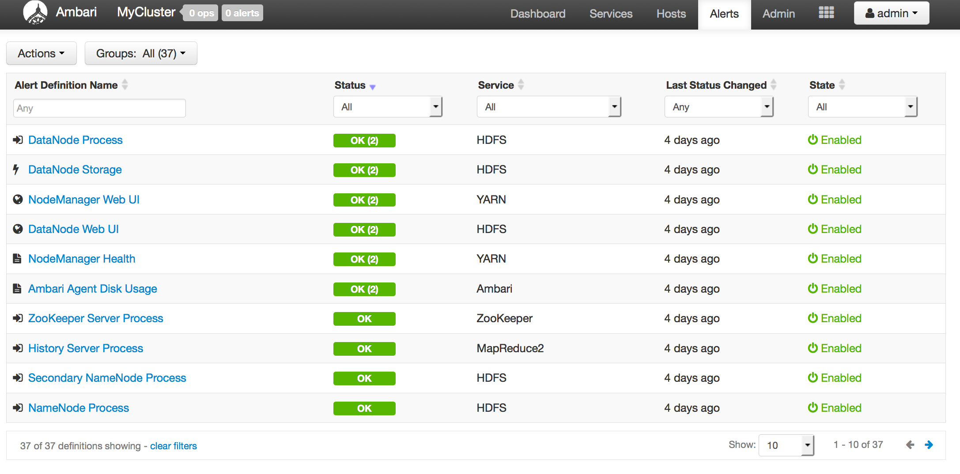
Full Visibility into Cluster Health
Centralized management of Health Alerts
Pre-defined alerts, configured by default on cluster install

Slide 7
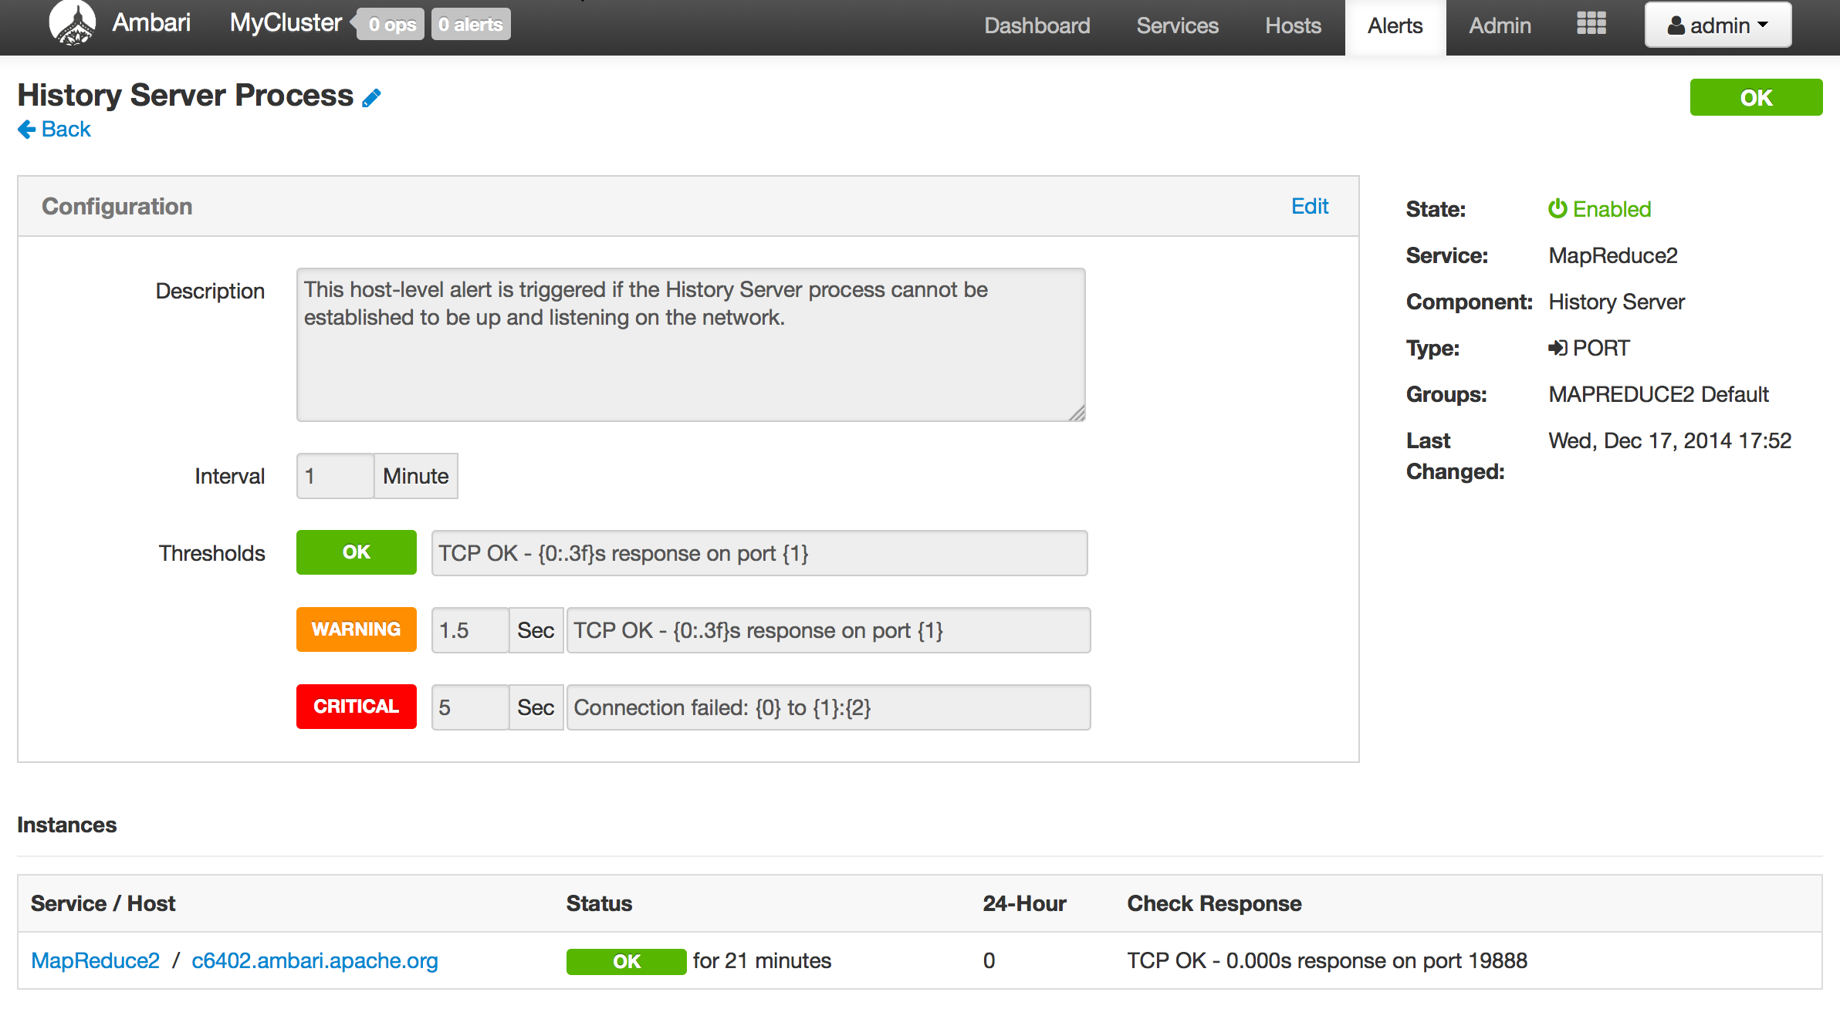
Customizing Alerts
Control thresholds, check intervals and response text
Notes:
What: Create and manage multiple notification targets
Control who gets notified when
Why: Filter by severity
Send only certain notifications to certain targets based on severity
How: Control dispatch method
Support for EMAIL + SNMP

Slide 8
Configuring the Check Count
Set globally for all alerts, or override for a specific alert
Global Setting
Alert Override

Slide 9
Ambari Alerting System
User creates or modifies cluster
Ambari reads alert definitions from Stack
Ambari sends alert definitions to Agents and Agent schedules instance checks
Agents reports alert instance status in the heartbeat
Ambari responds to alert instance status changes and dispatches notifications (if applicable)
email
snmp
5
Ambari
Server
1
3
Ambari
Agent(s)
4
2
Stack definition
alerts.json
Notes:
There are REST APIs for alerts.

Slide 10
Ambari Metrics

Slide 11
Ambari Metrics
Built using Hadoop technologies
Three components: Metrics Collector, Metrics Monitors, Grafana
Phoenix
ATS
HBase
Local Filesystem or HDFS

Slide 12
Metrics Collection
Metric Monitors send system-level metrics to Collector
Sinks send Hadoop-level metrics to Collector
Metrics Collector service stores and aggregates metrics
Ambari exposes REST API for metrics retrieval
Ambari
Server
Metrics Collector
4
3
1
2
Metrics Monitor
Sink(s)
Metrics Monitor
Sink(s)
Metrics Monitor
Sink(s)
Host1
Host1
Hosts

Slide 13
Ambari Metrics + Grafana: Introduced with Ambari 2.2
Highlights
List of Dashboards widgets
Including Grafana as a “Native UI” for Ambari Metrics
Including pre-build Dashboards
Supports configuring for HTTPS
System Home, Servers
HDFS Home, NameNodes, DataNodes
YARN Home, Applications, Job History Server
HBase Home, Performance, Misc

Slide 14
Ambari Blueprints

Slide 15
Before Ambari
Manual Installation
Manual configuration
Manual distribution of configuration
XML
XML
XML

Slide 16
Ambari Blueprints
Two primary goals of Ambari Blueprints:
Provide API-driven deployments based on self-contained cluster description
Ability to export a complete cluster description of a running cluster
Blueprints contain cluster topology and configuration information
Enables interesting use cases between physical and virtual environments

Slide 17
Ambari Stacks + Blueprints Together
Stack Definition
Component Layout & Configuration
BLUEPRINT
BLUEPRINT
HOSTS
CLUSTER
INSTANTIATE

Slide 18
Blueprints API
BLUEPRINT
1
POST /blueprints/my-blueprint
CLUSTER
CREATION
TEMPLATE
2
POST /clusters/MyCluster

Slide 19
Example: Single-Node Cluster
BLUEPRINT
Description
Single-node cluster
Use HDP 2.2 Stack
HDFS + YARN + MR2
Everything on c6401
{
"configurations" : [
{
”hdfs-site" : {
"dfs.namenode.name.dir" : ”/hadoop/nn"
}
}
],
"host_groups" : [
{
"name" : ”uber-host",
"components" : [
{ "name" : "NAMENODE” },
{ "name" : "SECONDARY_NAMENODE” },
{ "name" : "DATANODE” },
{ "name" : "HDFS_CLIENT” },
{ "name" : "RESOURCEMANAGER” },
{ "name" : "NODEMANAGER” },
{ "name" : "YARN_CLIENT” },
{ "name" : "HISTORYSERVER” },
{ "name" : "MAPREDUCE2_CLIENT” }
],
"cardinality" : "1"
}
],
"Blueprints" : {
"blueprint_name" : "single-node-hdfs-yarn",
"stack_name" : "HDP",
"stack_version" : "2.2"
}
}
CLUSTER CREATION TEMPLATE
{
"blueprint" : "single-node-hdfs-yarn",
"host_groups" :[
{
"name" : ”uber-host",
"hosts" : [
{
"fqdn" : "c6401.ambari.apache.org”
}
]
}
]
}

Slide 20
Security Setup

Slide 21
Authentication
Kerberos
LDAP/AD
PEM/Local Authentication
Custom

Slide 22
Kerberos
Hadoop Cluster
Kerberos is used to secure the Components in the cluster. Kerberos identities are managed via “keytabs” on the Component hosts.
Service Component A
Service Component B
Service Component C
Service Component D
keytab
keytab
keytab
keytab
Principals for the cluster are managed in the KDC.
Service Component X
Service Component X
Service Component X
Service Component X
KDC
keytab
keytab
keytab
keytab
Notes:
User provides KDC Admin Account credentials to Ambari
Ambari connects to KDC, creates principals (Service and Ambari) needed for cluster
Ambari generates keytabs for the principals
Ambari distributes keytabs to Ambari Server and cluster hosts
Ambari discards the KDC Admin Account credentials

Slide 23
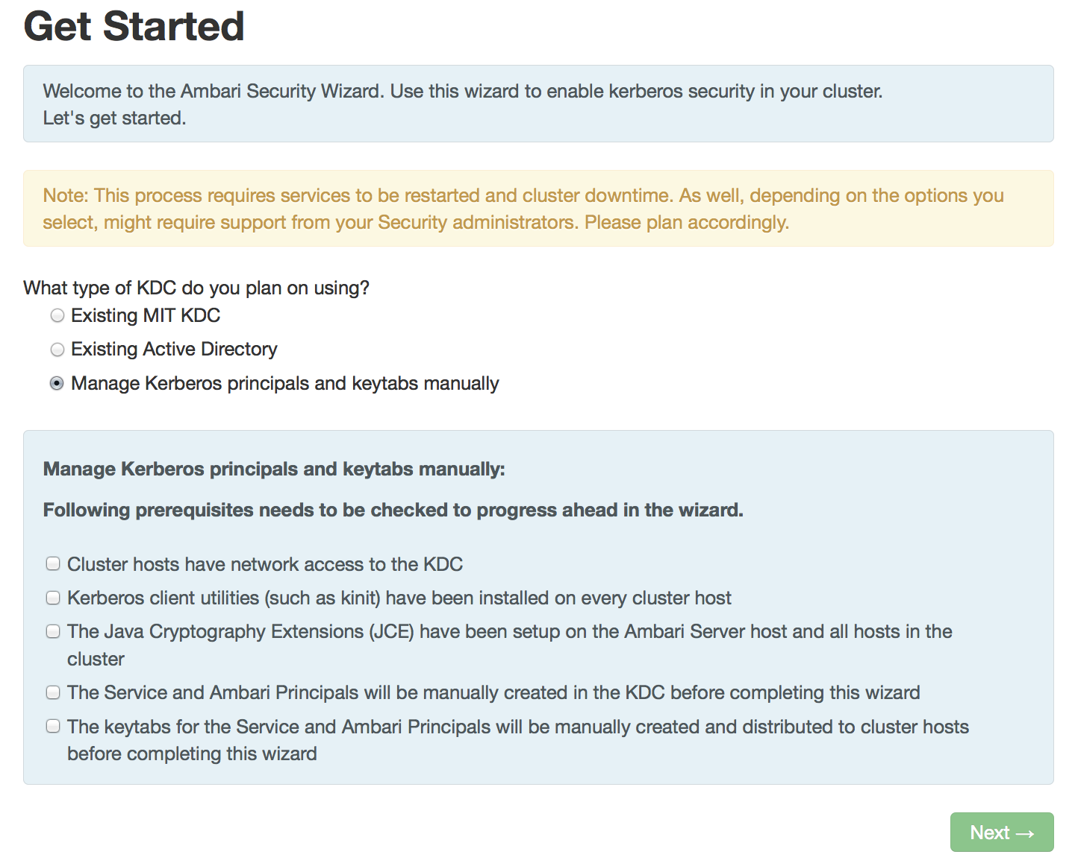
Automated Kerberos Security Setup
Wizard Driven Simplify the experience of enabling and managing Kerberos security
Automated and Manual Options Critical for today’s enterprise
Works with Existing Kerberos Infrastructure Such as Active Directory and MIT KDC

Slide 24
Role-Based Access Control (RBAC)

Slide 25
Role-Based Access Control
Use “roles” for more granular division of control for cluster operations
Old Permission | New Role | Notable Permissions
Operator | Cluster Administrator | Full operational control, including upgrades. Ambari Admins are implicitly granted this Role.
 | Cluster Operator | Adding and removing hosts.
 | Service Administrator | Manage configurations, move components.
 | Service Operator | Service stop and start and service-specific operations such as HDFS Rebalance.
Read-Only | Cluster User | View cluster service and host information.
Note: Users flagged as “Ambari Admins” are implicitly granted Cluster Administrator permission.

Slide 26
Managing Cluster Roles
Assign roles to users or groups
Manage roles in Block or List View layouts

Slide 27
Managing Cluster Roles
View users or groups
Change current role assignment

Slide 28
Automated Cluster Upgrade
Notes:
Why to upgrade?

Slide 29
Automated Upgrade: Rolling or Express Choice
Check Prerequisites
Prepare
Register + Install
Perform Upgrade
Finalize
Review the prerequisites to confirm your cluster configuration is ready for upgrade
Perform the preparation steps, which include making backups of critical cluster metadata.
Register the software repository and install the target version on the cluster.
Perform the upgrade. The steps depend on upgrade method: Rolling or Express.
Finalize the upgrade, making the target version the current version.
Notes:
Steps of overall upgrade process
Backup of critical cluster metadata
Change the symlinks

Slide 30
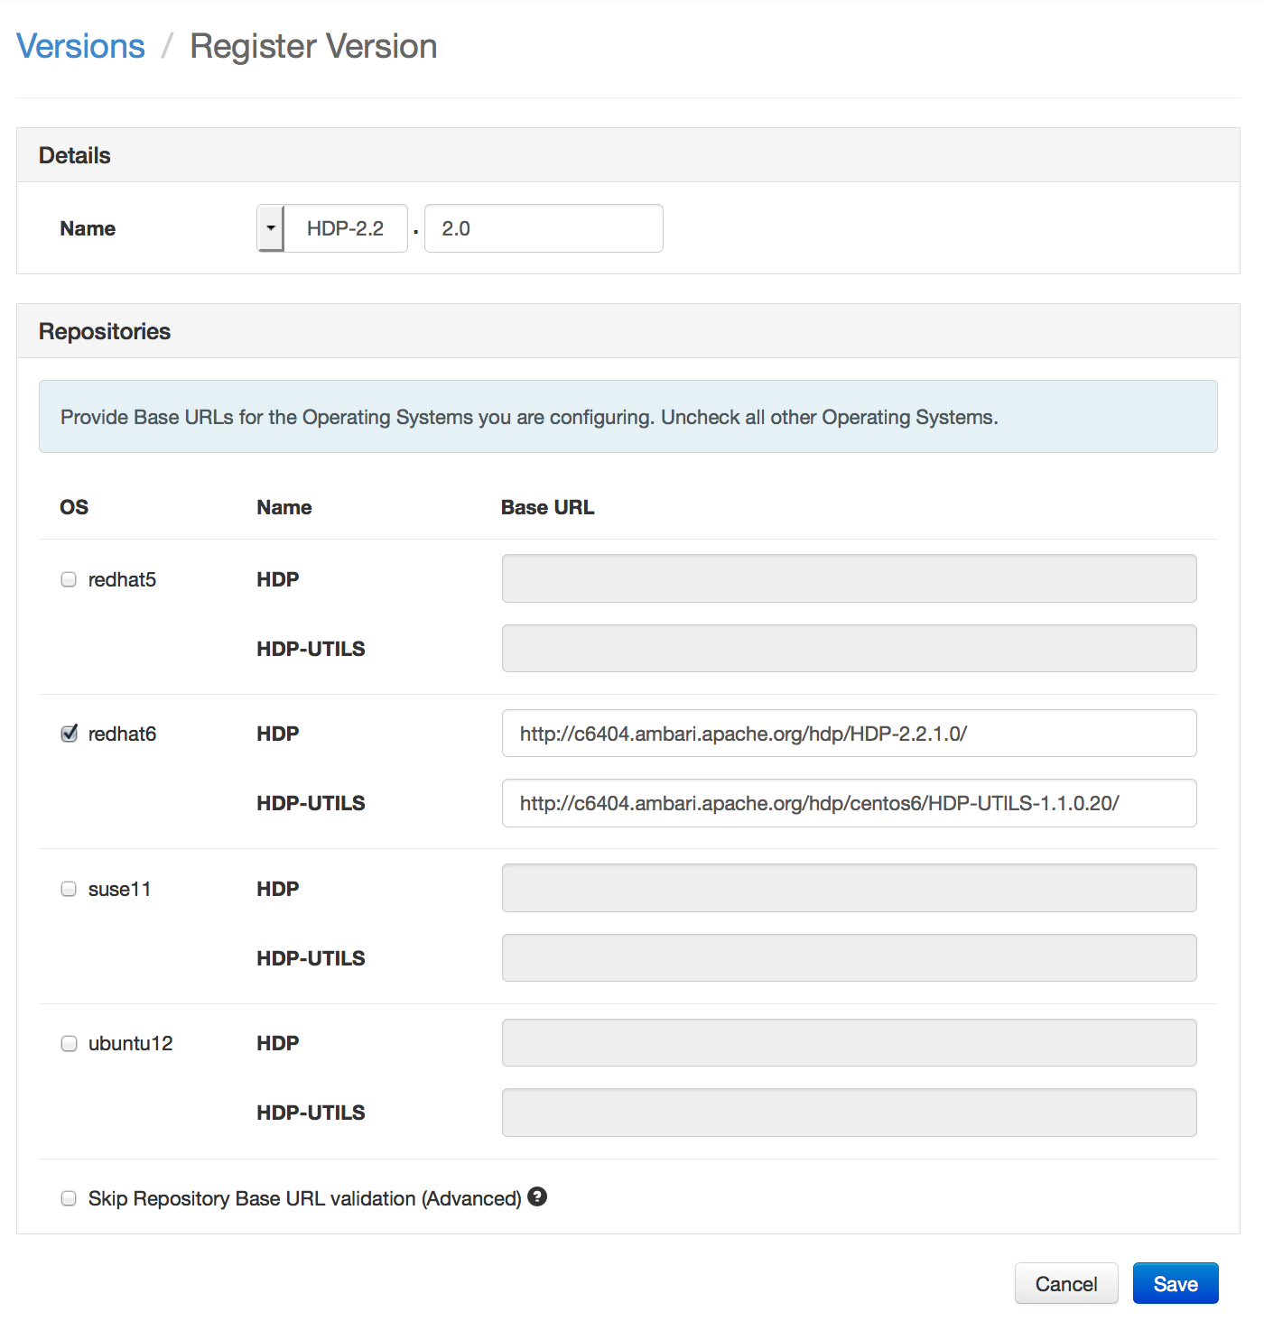
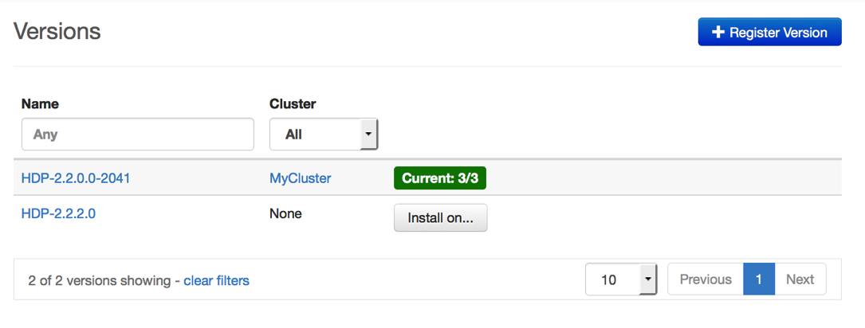


Register New Version
Register
Install
Perform
Upgrade
Finalize
Register new version with Ambari
Provide the Repository Base URLs for new version

Slide 31
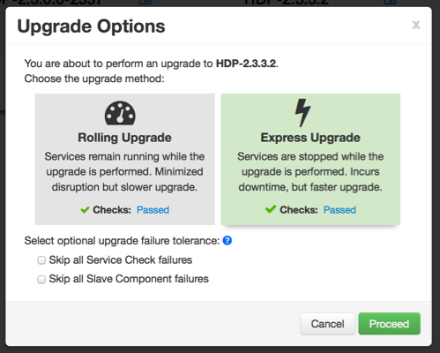
Upgrade Choice: Rolling or Express
Register
Install
Perform
Upgrade
Finalize
Notes:
Key Difference is there is a downtime in Express Upgrade as all the services are down once.
Rolling Upgrade: Orchestrates the cluster upgrade in an order that is meant to preserve cluster operation and minimize service impact. The tradeoff is more stringent prerequisites and a longer upgrade time.
Express Upgrade: Orchestrates the cluster upgrade in an order that will incur cluster downtime. This method has less stringent prerequisites but completes in a faster upgrade time.

Slide 32
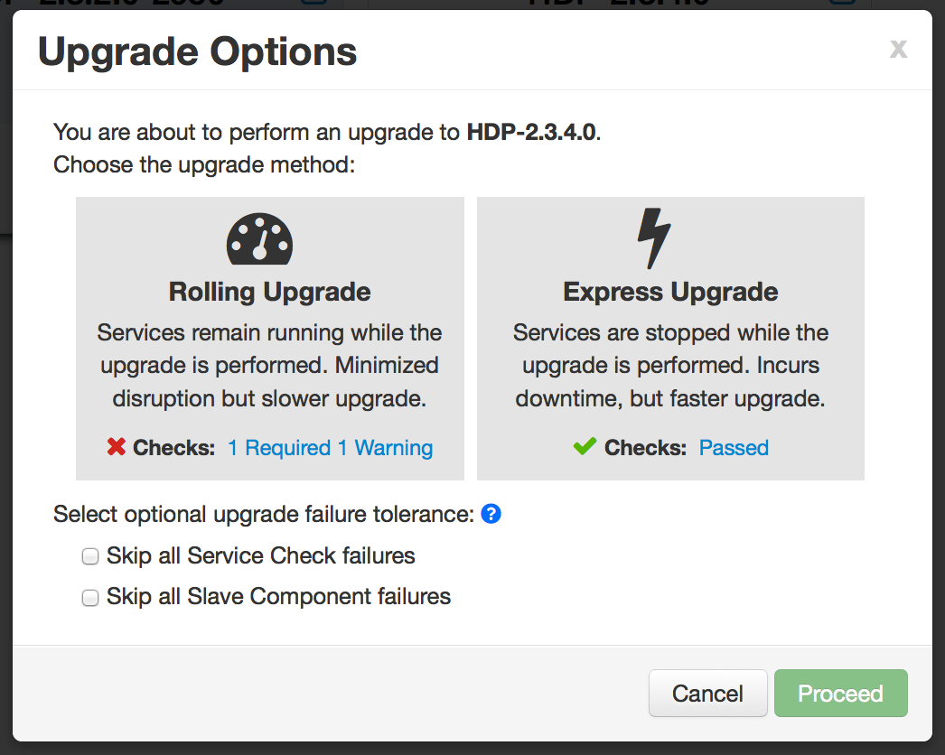
Upgrade Choice: Rolling or Express
Register
Install
Perform
Upgrade
Finalize
New options to handle failures
Notes:
Skip all Service Check failures: Ambari will automatically skip any Service Check failures and complete the task without requiring user intervention to continue. After all the Service Checks have run in a task, you will be presented with summary of the failures and an option to continue the upgrade or pause.
Skip all Slave Component failures: Ambari will automatically skip any Slave Component failures and complete the task of upgrading Slave components without requiring user intervention to continue. After all Slave Components have been upgraded, you will be presented with a summary of the failures and an option to continue the upgrade or pause.

Slide 33
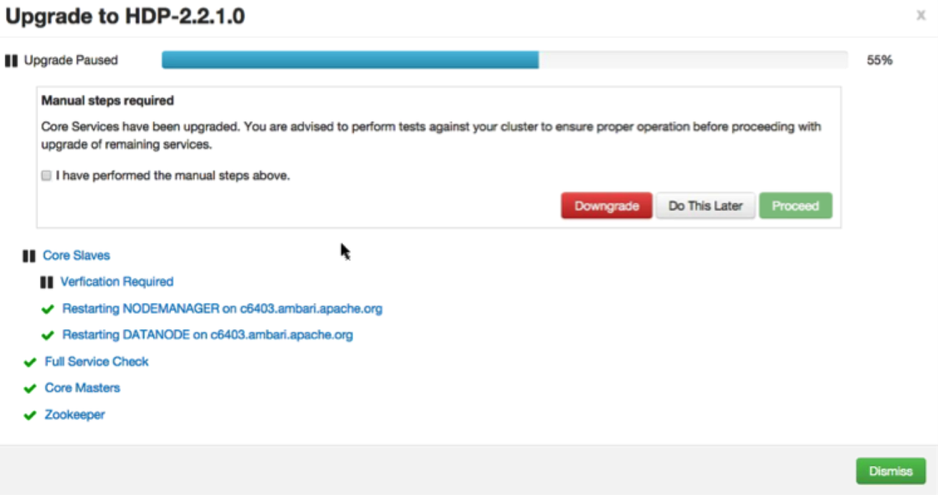
Wizard Driven Experience
Register
Install
Perform
Upgrade
Finalize
With verification and validation

Slide 34
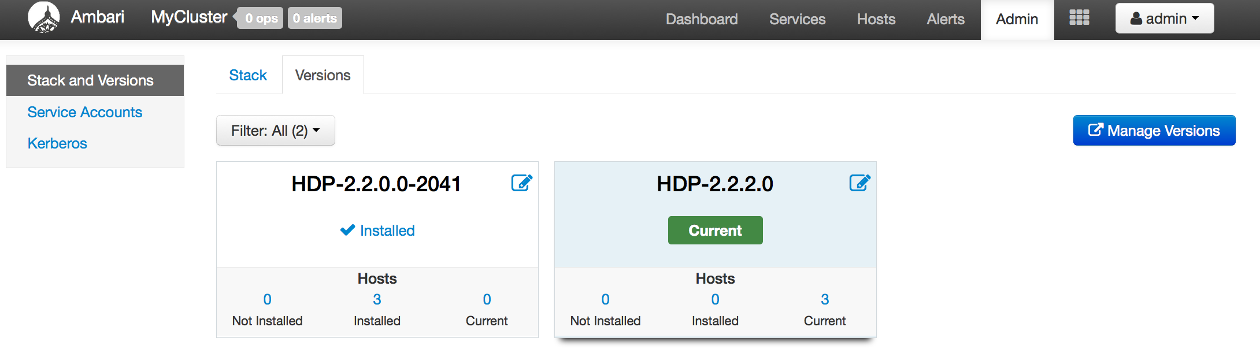
Rolling Upgrade – Success!
Register
Install
Perform
Upgrade
Finalize

Slide 35
Ambari Extensibility

Slide 36
Anatomy of Ambari Extension Points
Ambari
Web
Ambari
Server
Ambari
Agent
Ambari
Agent
Ambari
Agent
Stacks
js
java
Stacks
python
Stacks
Ambari Views
Ambari Stacks
Notes:
Technical anatomy of Ambari
Stacks: To add new Services beyond Stack, To customize a Stack for customer specific environments
Views: To extend and customize the Ambari Web UI, Add new capabilities, customize existing capabilities

Slide 37
Ambari Stacks

Slide 38

Ambari Stacks
Defines a consistent Stack lifecycle interface that can be extended
Encapsulates Stack Versions, Services, Components, Dependencies, Cardinality, Configurations, Commands
Dynamically add Stack + Service definitions
AMBARI
{rest}
HDFS
YARN
MR2
Stacks
Hive
HBase
Oozie
<ambari-web>
Falcon
Pig
Storm
Notes:
Stack: A set of Services, where to obtain the software packages and how to manage the lifecycle. (HDP 2.5, HDP 2.6)
Service: Defines the Components that make-up the Service. (HDFS, YARN, HIVE, SPARK)
Component: The building-blocks of a Service, that adhere to a certain lifecycle. (NAMENODE, DATANODE)

Slide 39
Stack Mechanics
Stacks define Services + Repos
What is in the Stack, and where to get the bits
Each Service has a definition
What Components are part of the Service
Each Service has defined lifecycle commands
start, stop, status, install, configure
Lifecycle is controlled via command scripts
Ability to define “custom” commands
AMBARI
SERVER
Repos
AMBARI
AGENT/S
Stack
AMBARI
AGENT/S
AMBARI
AGENT/S
Service Definitions
Command Scripts
xml
python
Notes:
Overrides any Service definitions, commands and configurations
Adds new Services specific to this Stack
Defines a set of Service definitions
Default service configurations and command scripts

Slide 40
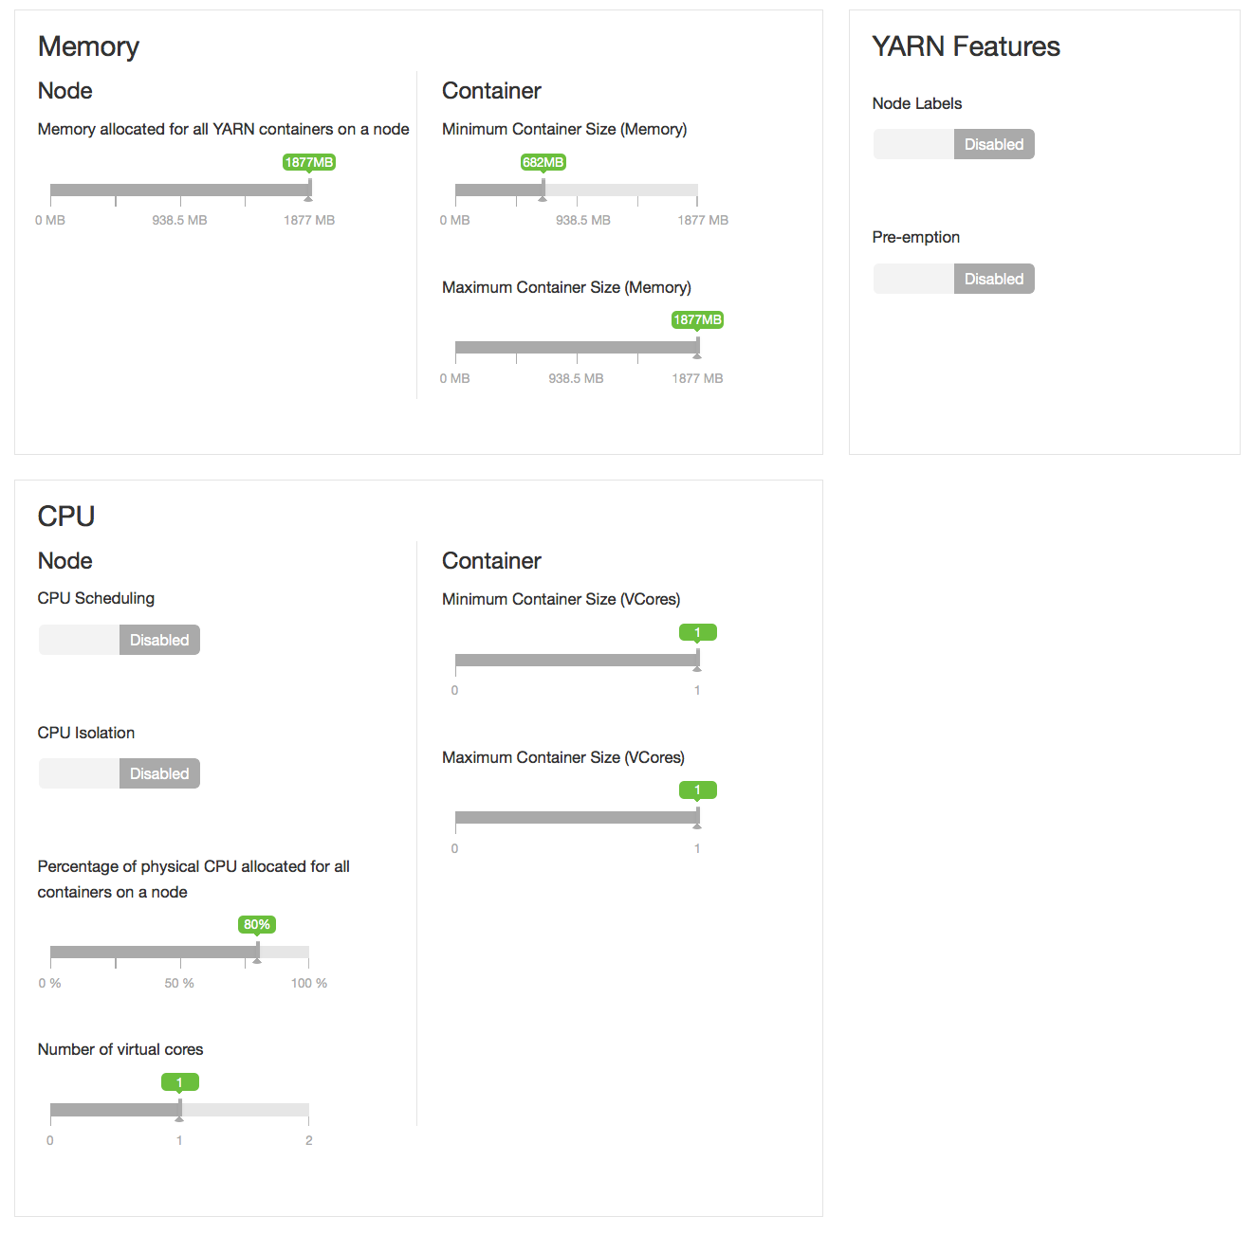
Smart Configurations using theme.json
Notes:
Take the guesswork out of cluster configuration
Driven by Stack definition
Intuitive layout and grouping of configurations
Smart UI controls to make it easier to set values
Recommendations and cross-service dependency checks

Slide 41
Ambari Views

Slide 42
Views Framework vs. Views
Views
Built by Hortonworks, Community, Partners
Views Framework
Core to Ambari
Notes:
Developers can extend the Ambari Web interface: Views expose custom UI features for Hadoop Services
Ambari Admin can entitle Views to Ambari Web users: Entitlements framework for controlling access to Views

Slide 43
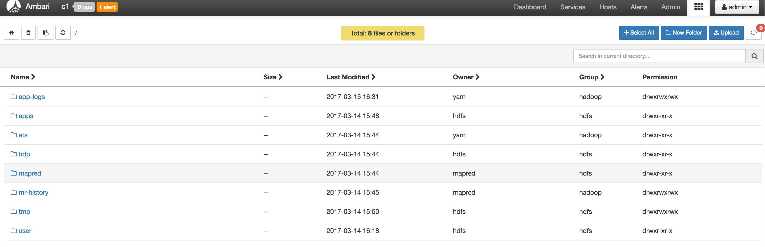
Files View
Notes:
UI version of Hadoop terminal
All the terminal operations like create directory, copy file, remove file, chmod etc are possible through this UI.

Slide 44
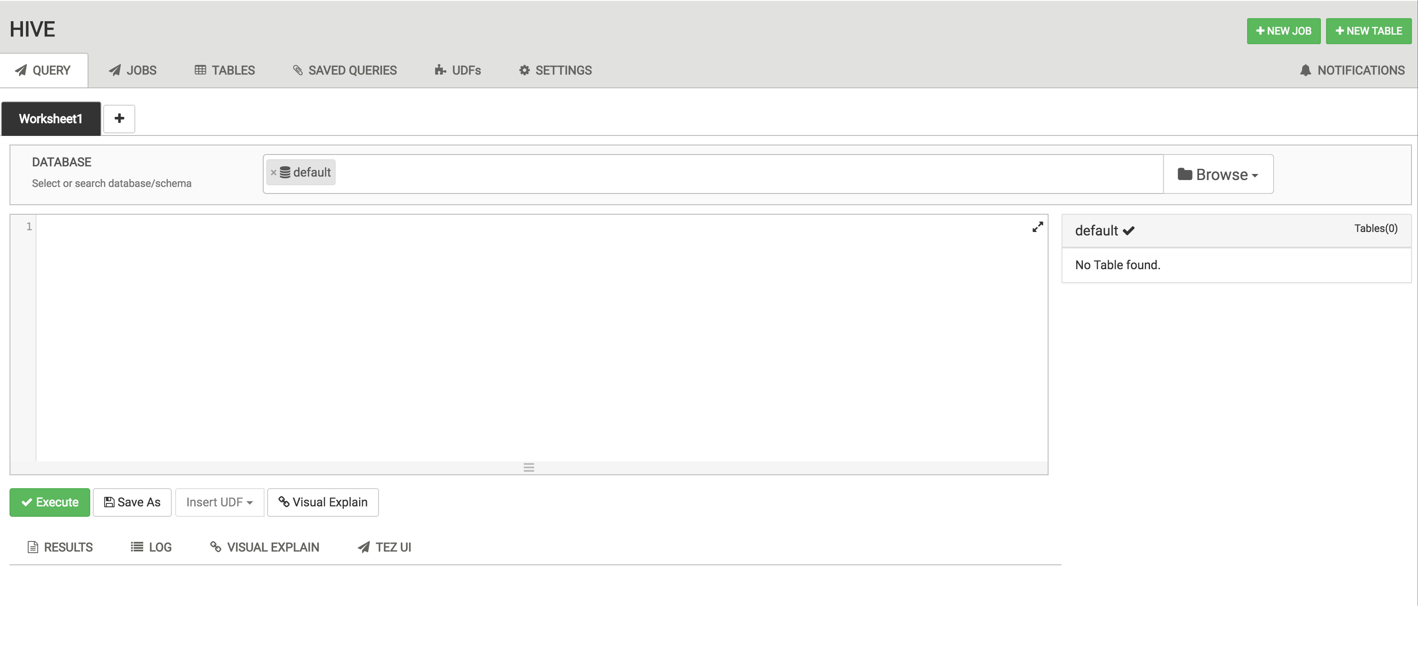
Hive 2.0 View
Notes:
UI project for Hive Query Engine
Can execute queries, multiple queries through UI. Can visualize the a complex query

Slide 45
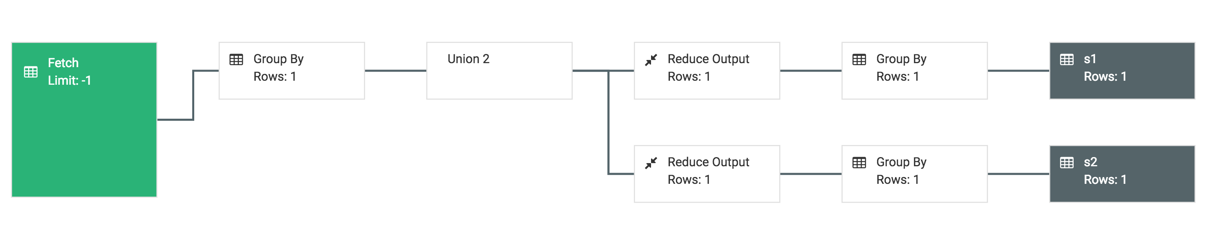
Hive 2.0 : Visual Explain Feature
Notes:
Can visualize the a complex query

Slide 46

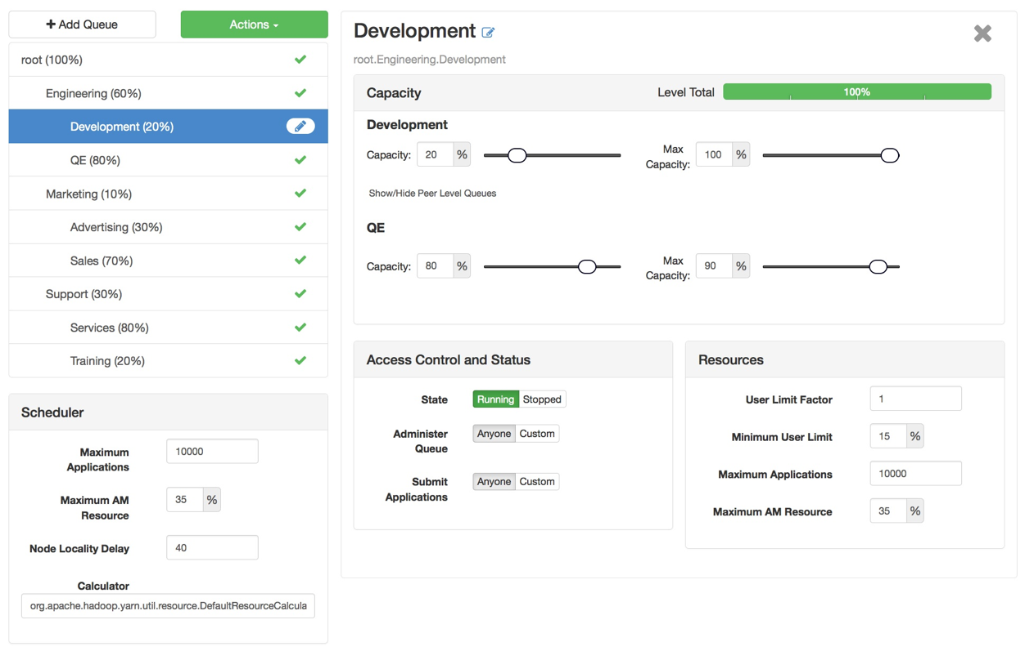
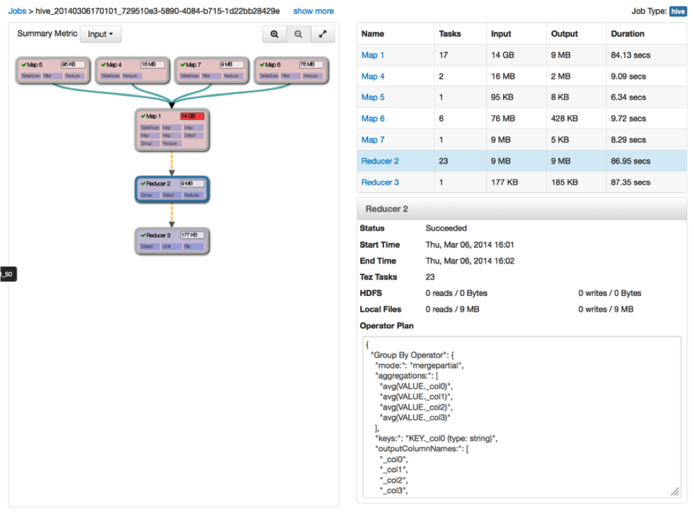
Some More Views
Capacity Scheduler
“Queue Manager” View
Tez
“Jobs” View

Slide 47
View Components
Serve client-side assets (such as HTML + JavaScript)
Expose server-side resources (such as REST endpoints)
AMBARI WEB
AMBARI SERVER
VIEW
Client-side assets
(.js, html)
VIEW
Server-side resources
(java)
Hadoop and other systems
{rest}

Slide 48
View Delivery
Develop the View (just like you would for a Web App)
Package as a View (basically a JAR)
Deploy the View into Ambari
Ambari Admins create + configuration view instance(s) and give access to users + groups
Can Deploy multiple versions and create multiple instances of a view
Develop
Package
Deploy
Create Instance(s)

Slide 49


Choice of Deployment Model
For Hadoop Operators:
Deploy Views in an Ambari Server that is managing a Hadoop cluster
For Data Workers:
Run Views in a “standalone” Ambari Server
Operators manage the cluster, may have Views deployed
Ambari
Server
HADOOP
Store & Process
Data Workers use the cluster and use a “standalone” Ambari Server for Views
Ambari
Server

Slide 50
Learn More About Apache Ambari
Resource | Location
Apache Ambari Project Page | http://ambari.apache.org
Ambari Project Wiki | https://cwiki.apache.org/confluence/display/AMBARI
Ambari Project JIRA | https://issues.apache.org/jira/browse/AMBARI
Stacks | https://cwiki.apache.org/confluence/pages/viewpage.action?pageId=38571133
Blueprints | https://cwiki.apache.org/confluence/display/AMBARI/Blueprints
Views | https://cwiki.apache.org/confluence/display/AMBARI/Views

Slide 51
Thank You

